Slide 1





Knowledge
Partner
Innovation Sprint 2025 (Capstone Project).
Name : Prince Ch Boro
Dept: BCA 5th Sem
DT: 55
Cohort Mentor: Udipta Das

Slide 2
Problem Statement
Digital KYC: Reduce Drop-Off, Lift Conversion Goal Improve conversion in the digital KYC journey for youth/new-to-bank customers.
  Reduce abandonment and rejections.
  Improve TAT (faster completion).
  Provide clear next-step visibility to customers.
  Reduce re-submissions and multiple attempts.

Slide 3
Problem Context
HDFC Bank has launched a digital KYC onboarding process
5-step journey: Select Document → Scan → Upload → KYC Check → KYC Approval
Since go-live, there is:
  High rejection rate
  High drop-off during process
  TAT (Turnaround Time) issues

Slide 4
Current KYC Flow
Horizontal flow:
Select Document → Scan Document → Upload Document → KYC Check → KYC Approval
Mention:
3 attempts per stage; 4th attempt → auto rejection
PAN + Aadhaar mandatory for digital onboarding
Passport must have ≥ 6 months validity

Slide 5
Failure Percentage
Stage | Failure Percentage
Select Document Type | 15%
Scan Document | 35%
Upload Document | 25%
KYC Check | 15%
KYC Approval | 10%

Slide 6
Objectives of the Proposed Solution
Reduce failure at Scan & Upload stages
Improve first-time-right KYC completion
Provide:
  Better UX and guidance
  Faster or smoother backend validation
  Clear, actionable error messages
Demonstrate solution through a prototype of improved digital KYC flow

Slide 7
Proposed Enhancements (Process + UX)
Smart document guidance:
  PAN + Aadhaar mandatory → guide at the start
  Passport validity check: must be 6+ months
Real-time scan guidance:
  On-screen tips: lighting, alignment, glare
Attempts & progress visibility:
  Step progress bar

Slide 8
Prototype Overview
Built a web-based prototype simulating:
  4 main stages:
    Select document types
    Scan document (with guidance + validation)
    Upload document
    Photo + Selfie verification
  Attempts tracking per stage (max 3)
  Dynamic progress bar
  User-friendly messages and guidance

Slide 9
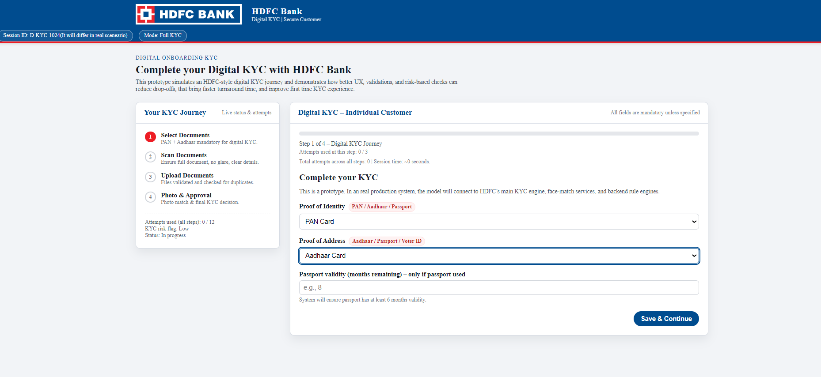
Prototype Screenshots

Slide 10
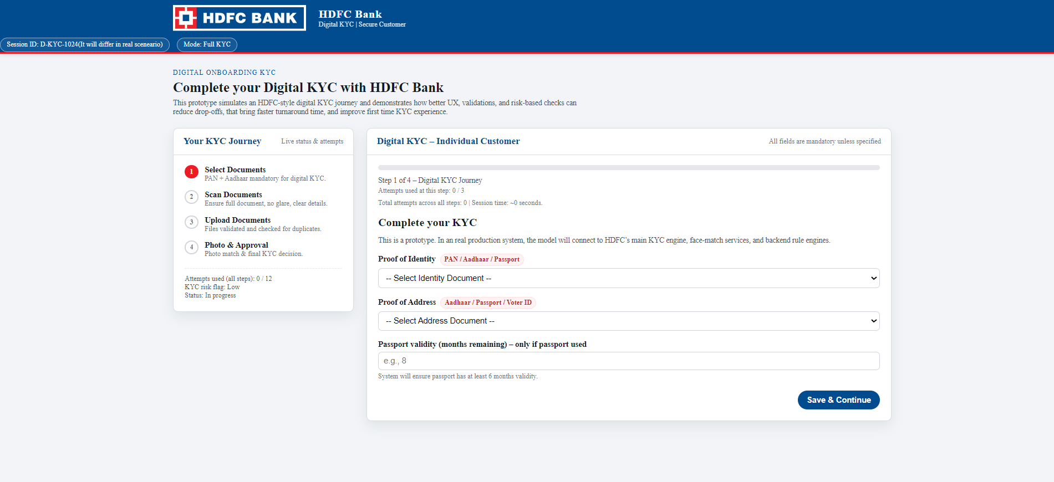

Slide 13
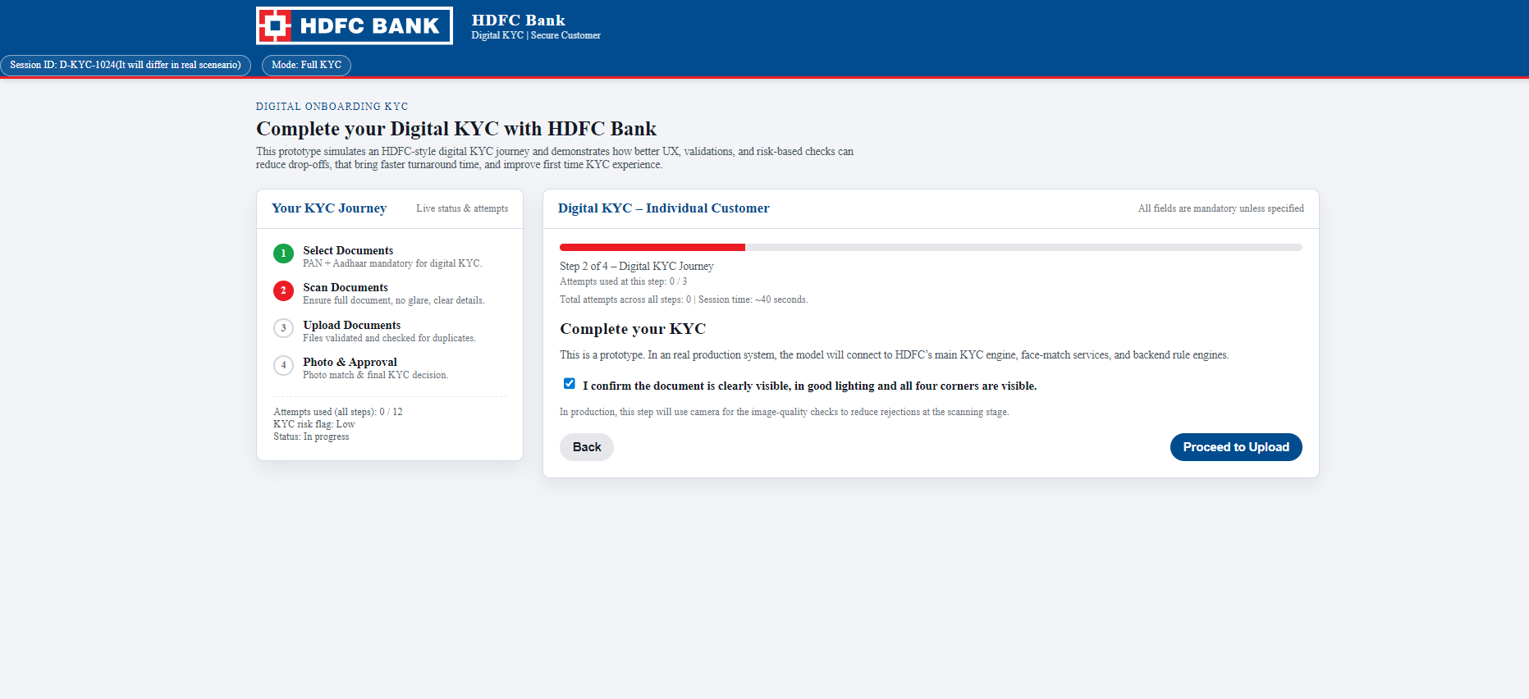

Slide 14
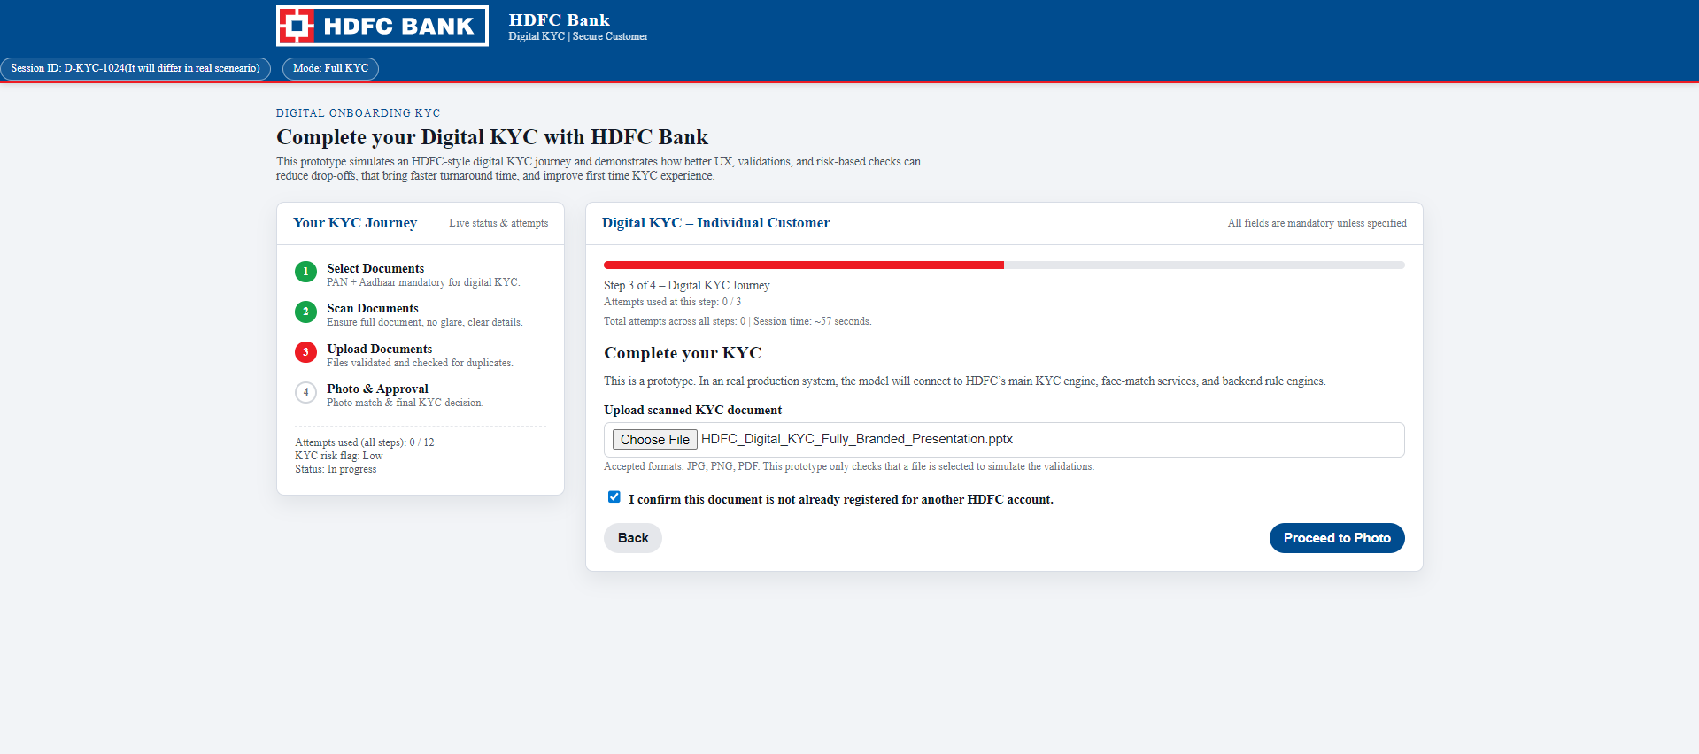

Slide 15
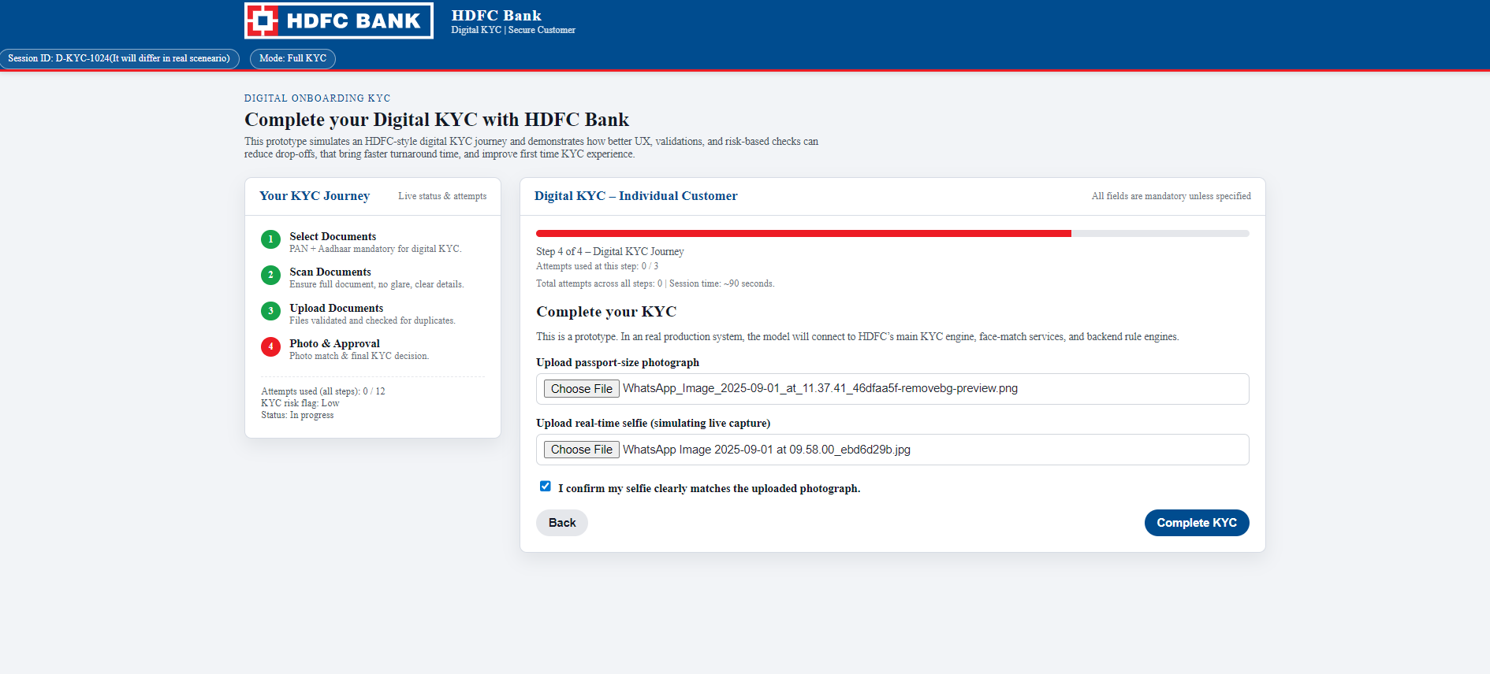

Slide 16
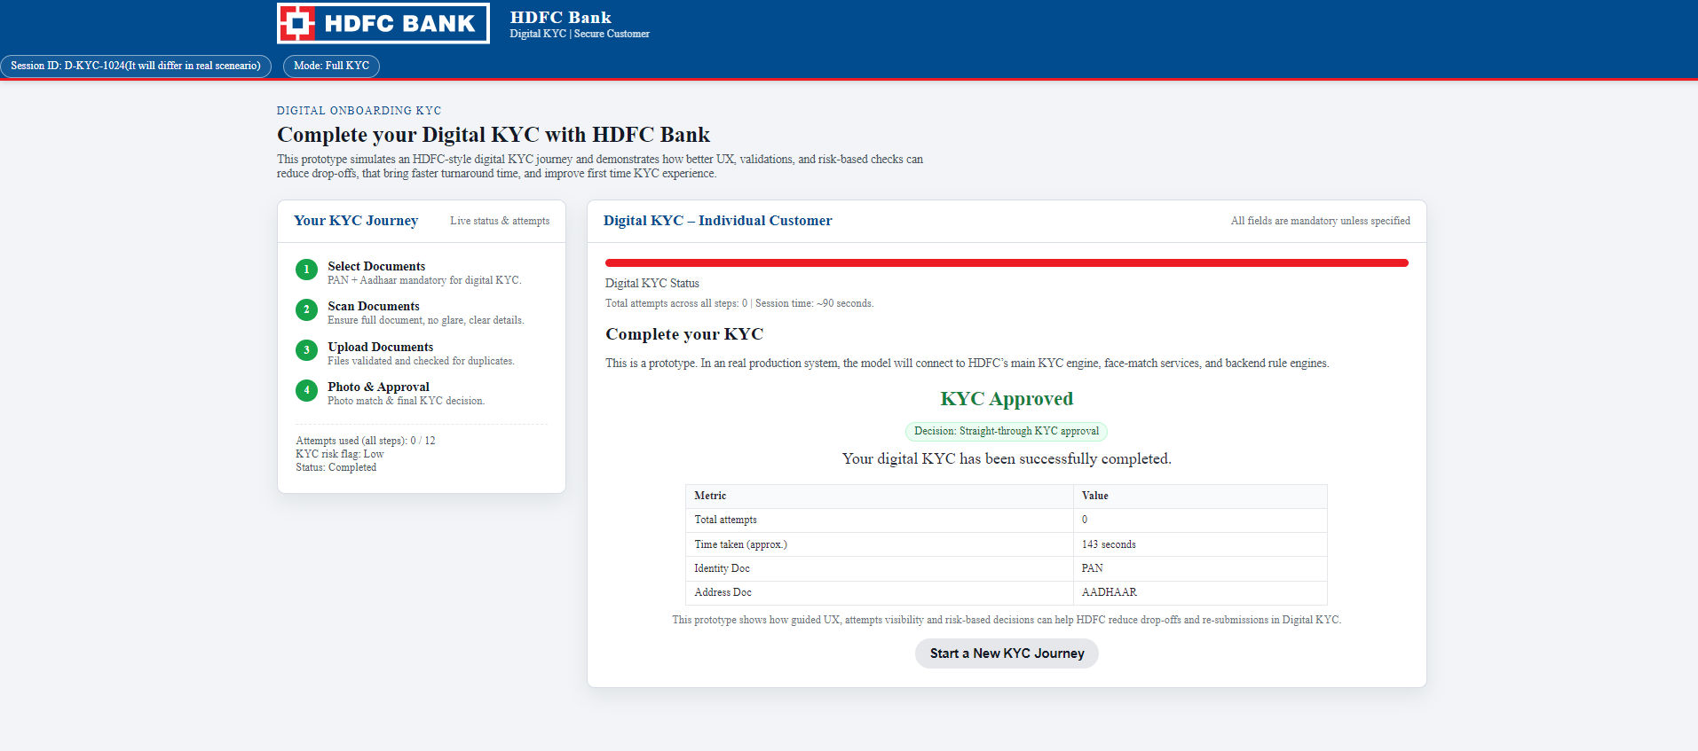

Slide 17
Expected Impact (Before vs After)
Before (Current Failure %):
  Select Doc: 15%
  Scan: 35%
  Upload: 25%
  KYC Check: 15%
  KYC Approval: 10%
After (Expected With Proposed Changes – Example):
  Select Doc: 8% (better guidance)
  Scan: 15% (real-time instructions, quality checks)
  Upload: 10% (clear messages, faster feedback)
  KYC Check: 7% (stronger upfront validation)
  KYC Approval: 5% (fewer re-submissions)

Slide 18
Conclusion
Summarize:
  Targeted biggest pain points (Scan + Upload)
  Improved user guidance, visibility, and attempts handling
  Reduced rejection and drop-off conceptually
Digital KYC experience becomes:
  Faster
  More transparent
  Less frustrating for the customer

Slide 19
Thank You

